Slide 1
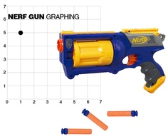
Equation of a Circle Using a Nerf Gun
By: Rachel McGinty

Slide 2
Goals:
Students will be able to plot points on a coordinate plane using prior knowledge.
Students will be able to discover the equation of a circle given points using prior knowledge.
Students will be able to take the general form of an equation of circle and convert to the standard form for an equation of a circle.

Slide 3
Objectives:
Given a Nerf gun, students will plot points on a coordinate plane. Students will then find the equation of a circle in standard form using 2 points.
Given a the general form for the equation of circle, students will convert the equation to standard form and will then name the center point and will plot/”shoot” the point.

Slide 4
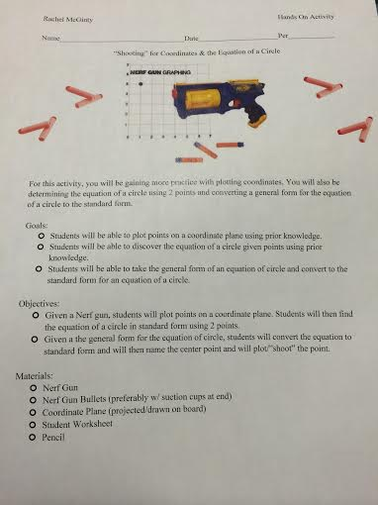
Materials:
Nerf Gun
Nerf Gun Bullets (preferably w/ suction cups at end)
Coordinate Plane (projected/drawn on board)
Student Worksheet
Pencil

Slide 5
Standards:
NYS Common Core
The Number System 6.NS
Apply and extend previous understandings of numbers to the system of rational numbers.
8. Solve real-world and mathematical problems by graphing points in all four quadrants of the coordinate plane. Include use of coordinates and absolute value to find distances between points with the same first coordinate or the same second coordinate.
Geometry 8.G
Understand and apply the Pythagorean Theorem.
8. Apply the Pythagorean Theorem to find the distance between two points in a coordinate system.
Expressing Geometric Properties with Equations G-GPE
Translate between the geometric description and the equation for a conic section
1. Derive the equation of a circle of given center and radius using the Pythagorean Theorem; complete the square to find the center and radius of a circle given by an equation.

Slide 6
Overview:
Each student will get the chance to “shoot” & record their points on the coordinate plane.
Students can choose to work with a partner or individually.
Students will complete student worksheet with guided steps in order to:
Find the equation of a circle given just a center point and point passing through.
Find the standard form equation of a circle given the general form.

Slide 7
Pre-Activity
Before beginning the activity, take the time to help the students recall prior knowledge related to finding the equation of a circle.
Use this time to also review with the students any definitions/equations that they will be using throughout the activity.
Notes:
For example: the radius is the distance from the center to any point on the circle so we should remember that we can use the distance formula given the center and a point.

Slide 8
Definitions & Equations
Circle: the set of all points on a plane that are a fixed distance from a center.
Completing the Square: the process of converting a quadratic equation into a perfect square trinomial by adding or subtracting terms on both sides.
Equations of a circle:
Standard Form: ${\left(x−h\right)}^{2}+{\left(y−k\right)}^{2}=r^{2}$
General Form: $x^{2}+y^{2}+Dx+Ey+F=0,$
$where D, E,F are constants$
Distance Formula:
$\sqrt{({x_{2}−x_{1})}^{2}+({y_{2}−y_{1})}^{2}}$

Slide 9
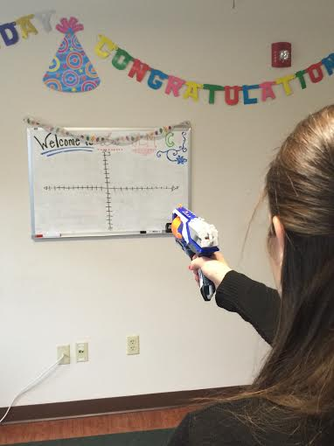
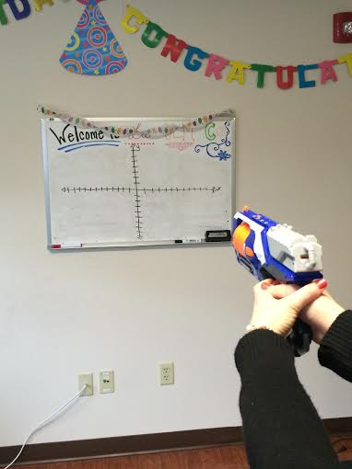
“Shooting” Points
Have the students each get a turn to “shoot” their points on the coordinate plane where they will then record them on the student worksheet.

Slide 10
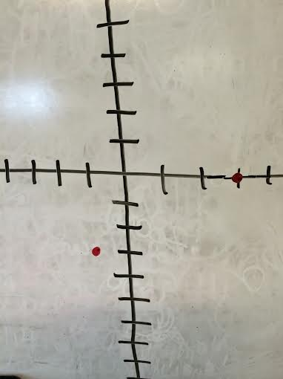
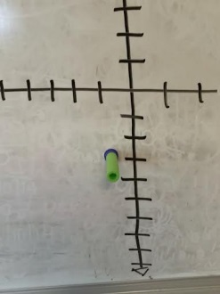
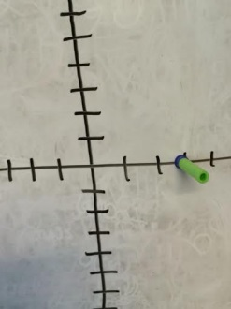
Equation of Circle w/ Center & Passing Through Point Step 1
Determine which of the two points will be the center and the “passing through the point”.
Example:
Center: (-1,-3)
Point: (3,0)

Slide 11
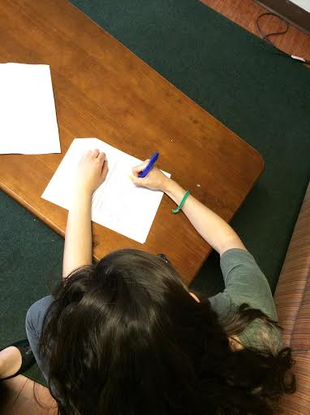
Step 2
Need to find the radius in order to find equation of a circle.
Use the distance formula!
Example:
$\left(x_{1},y_{1}\right)=\left(−1, −3\right) \left(x_{2},y_{2}\right)=\left(3, 0\right)$
$r=\sqrt{{\left(−3−\left(−1\right)\right)}^{2}+{\left(0−3\right)}^{2}}$
$r=5$

Slide 12
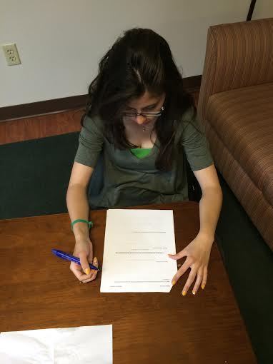
Step 3
Students will plug in information into the standard form of an equation of a circle.
For example: The center of a circle is also known as (h,k) when which is (-1,-3) and the radius is 5 therefore… ${\left(x−h\right)}^{2}+{\left(y−k\right)}^{2}=r^{2}$
${\left(x−(−1)\right)}^{2}+{\left(y−(−3)\right)}^{2}={(5)}^{2}$
${\left(x+1\right)}^{2}+{\left(y+3\right)}^{2}=25$
Equation of a circle!!

Slide 13
General Form To Standard form Step 1
Students will be given the equation of a circle in general form and will have to convert it to the standard form (the student handouts will be randomized with different equations so not every student has the same one).
Example:
$$2x^{2}+2y^{2}+6x−8y+12=0$$
Group the terms!
$$\left(2x^{2}+6x\right)+\left(2y^{2}−8y\right)=−12$$

Slide 14
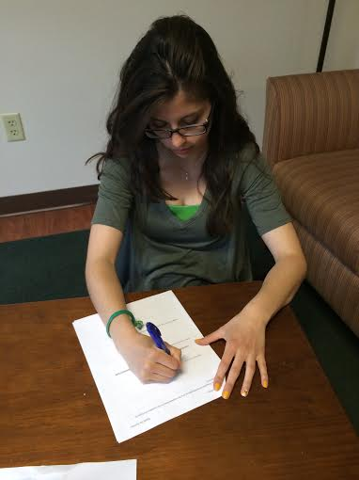
Step 2
Divide each term by the coefficient of $x^{2}and y^{2}$!
$$\left(2x^{2}+6x\right)+\left(2y^{2}−8y\right)=−12$$
$${(x}^{2}+3x)+{(y}^{2}−4y)=−6$$

Slide 15
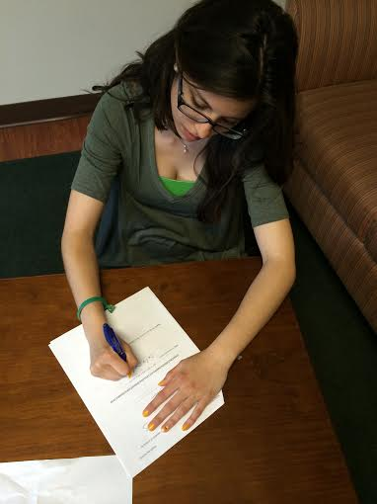
Step 3
Complete the Square!
$${(x}^{2}+3x)+\left(y^{2}−4y\right)=−6$$
$$\left(x^{2}+3x+{\left(\frac{3}{2}\right)}^{2}\right)+\left(y^{2}−4y+{\left(−2\right)}^{2}\right)=−6+{\left(\frac{3}{2}\right)}^{2}+{\left(−2\right)}^{2}$$
$$\left(x^{2}+3x+\frac{9}{4}\right)+\left(y^{2}−4y+4\right)=\frac{1}{4}$$
$${\left(x+\frac{3}{2}\right)}^{2}+{\left(y−2\right)}^{2}={\left(\frac{1}{4}\right)}^{2}$$
Equation of a circle!!

Slide 16
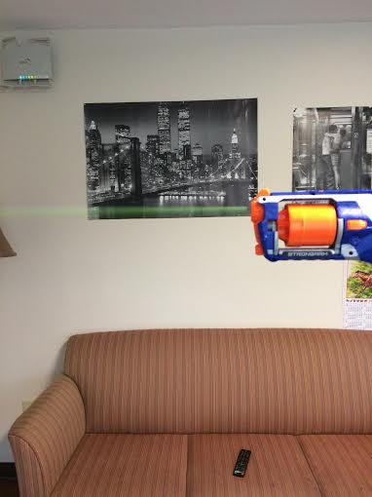
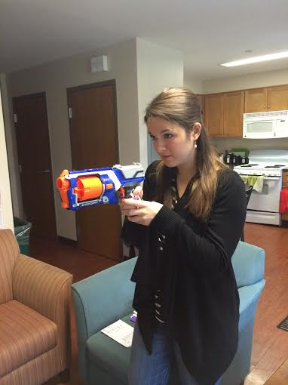
Step 4
Find the center and then plot/”shoot” it!
$${\left(x+\frac{3}{2}\right)}^{2}+{\left(y−2\right)}^{2}={\left(\frac{1}{4}\right)}^{2}$$
Center: (h,k) = $\left(−\frac{3}{2}, 2\right)$

Slide 17
Conclusions
Using the distance formula, you can find the radius of circle when given the center point and a point passing through circle.
${\left(x−h\right)}^{2}+{\left(y−k\right)}^{2}=r^{2}$ has center at (h, k)
The standard form can be derived from the general form using the Completing the Square method.

Slide 18
Additional Questions
Find the equation of a circle given the point (9,-5) and the center point (-4,-6).
Convert the equation of circle from general form to standard form and name the center. $x^{2}−2y+y^{2}+6x=2$
Convert to standard form and name the center. $3x^{2}+4x+3y^{2}−6y−4=0$
Given (1, 4) as the center point and (3, 7) as a point that passes through the circle find the equation of the circle.
☺ Bonus ☺
What would happen to your equations for #1 and #4 if you reflected the center points over the y-axis? The x-axis? The line y=x? Find your new equations for each and describe what happens.

Slide 19
References/Resources
http://www.algebra.com/algebra/homework/Circles.faq.question.61514.html
http://surfingtosuccess.blogspot.com/2012/09/using-nerf-gun-to-teach-coordinate-grid.html
http://www.mathsisfun.com/algebra/circle-equations.html
http://www.regentsprep.org/Regents/math/algtrig/ATC1/circlelesson.htm

